Slide 1

SQL
Nested Queries in Modifying Operations
Window Functions

Slide 2
Using Update, Delete, and Insert with Nested Queries

Slide 3
Advanced Data Modification Capabilities in SQL
SELECT INTO
Create a new table from a query
INSERT
Adding subquery results to a table
UPDATE
Filtering records to be modified
Set new values using a subquery
Reading values from related records to subsequently update table fields
DELETE
Filtering records to delete

Slide 4
Create a table from a query
You can create a new table from the query results:
SELECT * INTO new_table FROM …
SELECT expressions INTO table rest of the query;
This query can be useful if you need a separate set of data into a new table.
Example: This query will create a new table car_a:
select * into car_a from car where clsid = 'A';

Slide 5
Inserting query results
In SQL, you can use the results of a subquery to append them to an existing table.
INSERT INTO table1 (columns)
SELECT columns
FROM table2 …
Example:
insert into res_archive
select * from res
where start < '2018-02-01'

Slide 6
Update based on query result
You can read related records and use them as a source for an update operation:
UPDATE a
SET a.field1 = b.field2,
a.field3 = b.field3,
…
FROM table2 as b
WHERE a.id_a = b.id_a

Slide 7
Update based on query result
You can read related records and use them as a source for an update operation:
UPDATE a
SET a.field1 = b.field2,
a.field3 = b.field3,
…
FROM table2 as b
WHERE a.id_a = b.id_a
Updated table
Condition for matching records

Slide 8
Update based on query result
Example: Updating mileage in car_a from car table:
update car_a
set mileage = c.mileage
from car c
where car_a.cid = c.cid;
Updated table
Condition for matching records from car and car_a

Slide 9
Update based on query result
Other places where you can use subqueries in UPDATE:
SET
Scalar query
WHERE
Subqueries, as in a regular SELECT query
FROM
Derived table

Slide 10
Conditional deletion based on a subquery
В SQL you can add a subquery to the WHERE condition of a DELETE query
DELETE FROM table WHERE field1 in (SELECT field2 FROM …)
DELETE FROM table WHERE field1 = (SELECT field2 FROM …)
DELETE FROM table WHERE exists (SELECT 1 FROM …)
It is allowed to use conditions that are supported in SELECT queries.
Subqueries can be uncorrelated or correlated.

Slide 11
Conditional deletion based on a subquery
You need to delete all reservations that are already in the archive table.
delete from res where
exists ( select 1 from res_archive where
res_archive.bid = res.bid )

Slide 12
Using subqueries in modifying operations
You can create a table from the result of a query
SELECT - queries can be used inside INSERT, UPDATE and DELETE
SQL supports flexible syntax for performing calculations and modifications in a single query

Slide 13

Window functions
Introduction to Window Functions

Slide 14
Using Window Functions in SQL
Window functions add flexibility to SQL queries
What can you do with window functions?
Aggregation without group by
Calculating running totals
Aggregation within a sliding window
Reading previous and next records
Row ranking and numbering

Slide 15
Aggregation using window functions
Aggregation without row reduction

Slide 16
Calculating Totals Using Window Functions
The familiar aggregation functions are also available in the form of window functions.
Sum(x)
Avg(x)
Max(x)
Min(x)
Count(*), count(x)
and others

Slide 17
Calculating Totals Using Window Functions
The familiar aggregation functions are also available in the form of window functions.
Sum(x) OVER(...)
Avg(x) OVER(...)
Max(x) OVER(...)
Min(x) OVER(...)
Count(*) OVER(...), count(x) OVER(...)
and others
Instead of grouping in GROUP BY, you need to specify the parameters of the window boundary in which the calculations are performed
The OVER keyword is used for this
Window functions do not require GROUP BY in the query
Window functions can be applied to regular aggregate functions, but not vice versa

Slide 18
OVER() Window Borders Parameters
Two main parameters OVER
PARTITION BY a, b, c, ...
ORDER BY a, b, c, ....
OVER(partition by a, b, c order by x desc, y)
OVER(partition by a, b, c)
OVER(order by x desc, y)
OVER()
Grouping Rows
Ordering rows within each group
space

Slide 19
PARTITION BY in window function
Partition by groups rows before applying the function
Only values within one group will be passed to the function input
You can omit PARTITION BY. Then all rows of the query result will be in a single group
The number of rows does not decrease as a result

Slide 20
PARTITION BY in window function
The function will be executed in groups of rows in which the values of the expressions in partition by match.
Function OVER (PARTITION BY region)
Function OVER (
PARTITION BY extract(month from orderdate),
extract(year from orderdate)
)
Here the function will have access to the entire set of rows:
Function OVER ()

Slide 21
PARTITION BY in window function
The function will be executed in groups of rows in which the values of the expressions in partition by match.
Function OVER (PARTITION BY region)
Function OVER (
PARTITION BY extract(month from orderdate),
extract(year from orderdate)
)
Here the function will have access to the entire set of rows:
Function OVER ()
Grouping by region
Grouping by month of order placement
One group - all selected lines

Slide 22
PARTITION BY in window function
SUM(area) OVER (PARTITION BY region) as s_a
region
area
region
area
region
area
s_a
R1
10
R1
10
R1
10
70
R2
30
R1
50
R1
50
70
R2
20
R1
10
R1
10
70
R1
50
R2
30
R2
30
50
R1
10
R2
20
R2
20
50
The result with order by will be noticeably different

Slide 23
Aggregation without row reduction
It is necessary to determine the difference between the surface area of each country and the average area in the same region and in the world
Implementation options:
Approach #1. Query with a subquery in select
Approach #2: Query with a window function

Slide 24
Aggregation without row reduction
select
name,
region,
surfacearea,
surfacearea
- (select avg(surfacearea)
from country
where region=c.region)
as diff_region,
surfacearea
- (select avg(surfacearea)
from country)
as diff_world
from country c;
We calculate the difference between the area of each country and the average area in the same region and in the world
Approach #1. Query with a subquery in select

Slide 25
Aggregation without row reduction
select
name,
region,
surfacearea,
surfacearea
- (select avg(surfacearea)
from country
where region=c.region)
as diff_region,
surfacearea
- (select avg(surfacearea)
from country)
as diff_world
from country c;
We calculate the difference between the area of each country and the average area in the same region and in the world
Approach #1. Query with a subquery in select
Correlated subquery
Uncorrelated subquery

Slide 26
Aggregation without row reduction
select
name,
region,
surfacearea,
surfacearea
- (Average value within the same region)
as diff_region,
surfacearea
- (Worldwide average)
as diff_world
from country c;
We calculate the difference between the area of each country and the average area in the same region and in the world
Approach #2: Query with a window function

Slide 27
Aggregation without row reduction
select
name,
region,
surfacearea,
surfacearea
- avg(surfacearea)
over(partition by c.region)
as diff_region,
surfacearea
- avg(surfacearea)
over()
as diff_world
from country c;
We calculate the difference between the area of each country and the average area in the same region and in the world
Approach #2: Query with a window function

Slide 28
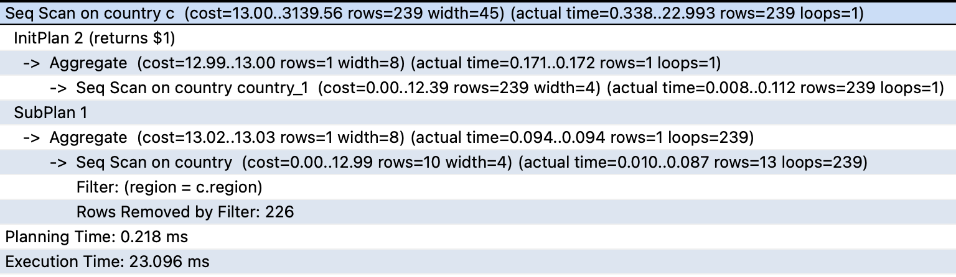
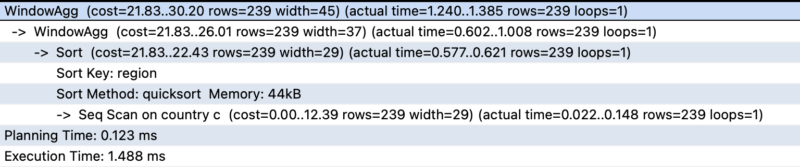
Plans
With subqueries
With window function

Slide 29
Plans
With subqueries
With window function
Sorting by region before calculations

Slide 30
Two-level aggregation with window function and grouping
Window functions can be used with the group by clause
Window functions can include aggregation functions. The results of the aggregation will be passed to the input of the window function
SELECT
continent,
region,
sum(surfacearea) region_area
FROM
country
GROUP BY
region, continent;
What will the query return?

Slide 31
Two-level aggregation with window function and grouping
Window functions can be used with the group by clause
Window functions can include aggregation functions. The results of the aggregation will be passed to the input of the window function
SELECT
continent,
region,
sum(surfacearea) region_area
FROM
country
GROUP BY
region, continent;
This query calculates the area of each region

Slide 32
Two-level aggregation with window function and grouping
We need to calculate the share of the region's area on the continent
And also calculate the ratio of the region's area to the area of the largest region on the same continent
SELECT
continent,
region,
sum(surfacearea) region_area
FROM
country
GROUP BY
region, continent;

Slide 33
Two-level aggregation with window function and grouping
We need to calculate the share of the region's area on the continent
And also calculate the ratio of the region's area to the area of the largest region on the same continent
SELECT
continent,
region,
sum(surfacearea) region_area,
sum(sum(surfacearea))
over(partition by continent)
as continent_area,
max(sum(surfacearea))
over(partition by continent)
as max_region_area
FROM
country
GROUP BY
region, continent;

Slide 34
Two-level aggregation with window function and grouping
The window function is applied to the area of the regions
sum( sum(surfacearea) )
over(partition by continent)
...
GROUP BY
region, continent
Calculating the area of a continent
SELECT
continent,
region,
sum(surfacearea) region_area,
sum(sum(surfacearea))
over(partition by continent)
as continent_area,
max(sum(surfacearea))
over(partition by continent)
as max_region_area
FROM
country
GROUP BY
region, continent;

Slide 35
Two-level aggregation with window function and grouping
The window function is applied to the area of the regions
max( sum(surfacearea) )
over(partition by continent)
...
GROUP BY
region, continent
Calculating the largest area of a region on a continent
SELECT
continent,
region,
sum(surfacearea) region_area,
sum(sum(surfacearea))
over(partition by continent)
as continent_area,
max(sum(surfacearea))
over(partition by continent)
as max_region_area
FROM
country
GROUP BY
region, continent;

Slide 36
Two-level aggregation with window function and grouping
Window functions can be added to expressions
SELECT
continent,
region,
sum(surfacearea) region_area,
sum(surfacearea) / sum(sum(surfacearea)) over(partition by continent)
as share_continent,
sum(surfacearea) / max(sum(surfacearea)) over(partition by continent)
as share_max_region
FROM
country
GROUP BY
region, continent;

Slide 37
WINDOW clause in Postgres
Window parameters can be made reusable within the context of a single request
SELECT
continent,
region,
sum(surfacearea) region_area,
sum(sum(surfacearea))
over(partition by continent)
as continent_area,
max(sum(surfacearea))
over(partition by continent)
as max_region_area
FROM
country
GROUP BY
region, continent;

Slide 38
WINDOW clause in Postgres
Window parameters can be made reusable within the context of a single request
SELECT
continent,
region,
sum(surfacearea) region_area,
sum(sum(surfacearea)) over(w) as continent_area,
max(sum(surfacearea)) over(w) as max_region_area
FROM
country
GROUP BY
region, continent
WINDOW
w as (PARTITION BY continent);

Slide 39
Limitations Regarding Window Functions
Window function cannot be used in filter
Window functions are not allowed in aggregate functions
count(distinct) is not supported in Postgres

Slide 40
Running totals calculations
Aggregation in a window function with sorting

Slide 41
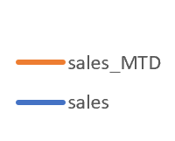
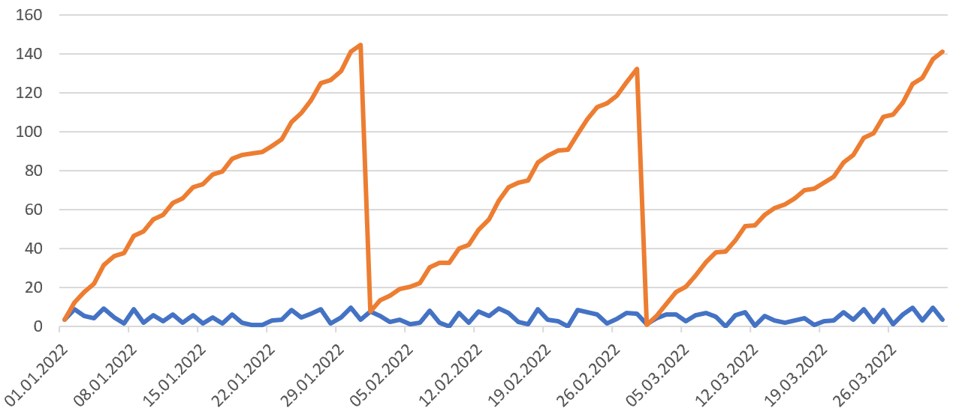
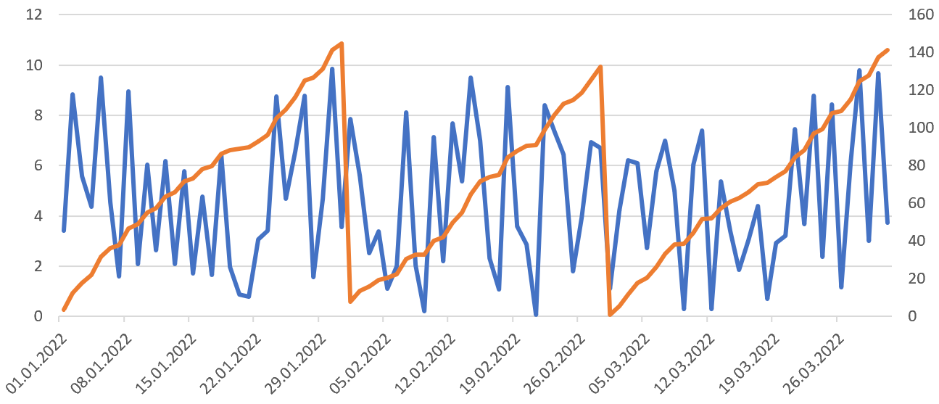
Running totals calculations
What is the difference between the blue graph and the orange one?
Daily Sales
Sales since the beginning of the month

Slide 42
Running totals calculations
What is the difference between the blue graph and the orange one?
Daily Sales
Sales since the beginning of the month
Sales since the beginning of the month are calculated on a running total.

Slide 43
Running totals calculations
What is the difference between the blue graph and the orange one?
In sorted data, sales_MTD can be calculated as the current value plus all previous values
In SQL this can be done in a window function with sorting
Sorted chronologically in each fragment
Fragment 1
Fragment 2
Fragment 3

Slide 44
ORDER BY in window function
Rows in groups can be sorted using ORDER BY
Function OVER(ORDER BY …,…,…)
ORDER BY can be added after PARTITION BY:
Function OVER(PARTITION BY …,…,… ORDER BY …,…,…)
Space

Slide 45
Calculating a running total using a window function
The group contains 4 rows
Record number in sorted section
Date | Sales
01.01.2022 | 10
02.01.2022 | 15
03.01.2022 | 10
04.01.2022 | 11
сортировка
1
10
group
2
10 15
group
A new row is added to the window.
3
10 15 10
группа
4
10 15 10 11
группа
Total sales on a date can be calculated as a Interim results
SELECT date, sum(total_sales) OVER(ORDER BY date) FROM tab

Slide 46
Calculating a running total using a window function
The group contains 4 rows
Record number in sorted section
Interim results
Дата | Продажи
01.01.2022 | 10
02.01.2022 | 15
03.01.2022 | 10
04.01.2022 | 11
сортировка
1
10
группа
10
2
10 15
25
группа
A new row is added to the window.
3
10 15 10
35
группа
4
10 15 10 11
46
группа
Total sales on a date can be calculated as a Interim results
SELECT date, sum(total_sales) OVER(ORDER BY date) FROM tab

Slide 47
Several options for calculating totals
select
f.actual_departure::date as actual_departure,
count(*) as departed_day
from
flights f
where
actual_departure between '2016-09-01' and '2016-10-01'
and f.departure_airport = 'VKO'
group by 1;
How many flights departed from Vnukovo each day?

Slide 48
Several options for calculating totals
select
f.actual_departure::date as actual_departure,
count(*) as departed_day,
sum(count(*)) over(order by f.actual_departure::date) as departed_by_date
from
flights f
where
actual_departure between '2016-09-01' and '2016-10-01'
and f.departure_airport = 'VKO'
group by 1;
How many flights departed from Vnukovo each day?
How many flights have already departed by the end of each day in a given period?

Slide 49
Several options for calculating totals
select
f.actual_departure::date as actual_departure,
count(*) as departed_day,
count(count(*)) over(order by f.actual_departure::date) as departed_by_date
from
flights f
where
actual_departure between '2016-09-01' and '2016-10-01'
and f.departure_airport = 'VKO'
group by 1;
Wrong way to calculate
How many flights departed from Vnukovo each day?
How many flights have already departed by the end of each day in a given period?

Slide 50
Another example with subtotals
You need to output the continent, country name, year of independence and the number of countries that became independent by that year.
select
c.continent,
c.name,
indepyear,
count(*) over(order by c.indepyear asc) as indepCountries
from country c;

Slide 51
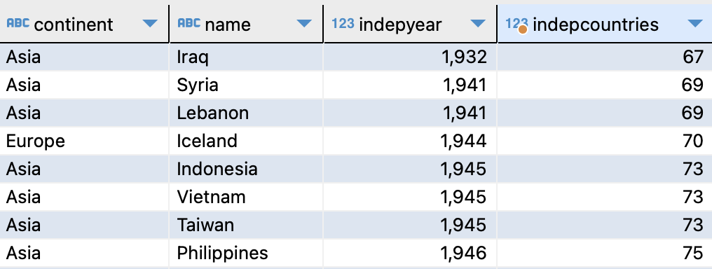
Another example with subtotals
For each year you can see the same values in indepcountries

Slide 52
Ranking with Window Functions
rank, dense_rank, row_number

Slide 53
Calculating a Row Number Using Window Functions
RANK() OVER(.. ORDER BY ..) – Each value is assigned a place number according to the sort settings, starting with 1. Rows with the same sort key are assigned the same number. In this case, unique numbers that could be assigned to rows with duplicate sort keys are excluded.
DENSE_RANK() OVER( .. ORDER BY ..) – Works the same as the previous function, but does not skip numbers in case of repetitions in the sort key.
ROW_NUMBER() OVER( .. ORDER BY ..) – Returns a unique sequence number in the sorted records

Slide 54
Ranking and row numbers
The query uses three functions to calculate the position of each region in the ranking by the number of countries
select region,
rank() over(order by count(*) desc) r_count,
dense_rank() over(order by count(*) desc) dr_count,
row_number() over(order by count(*) desc) rownumber
FROM country
group by region

Slide 55
Ranking and row numbers
The query uses three functions to calculate the position of each region in the ranking by the number of countries
select region,
rank() over(order by count(*) desc) r_count,
dense_rank() over(order by count(*) desc) dr_count,
row_number() over(order by count(*) desc) rownumber
FROM country
group by region
Counting the number of rows

Slide 56
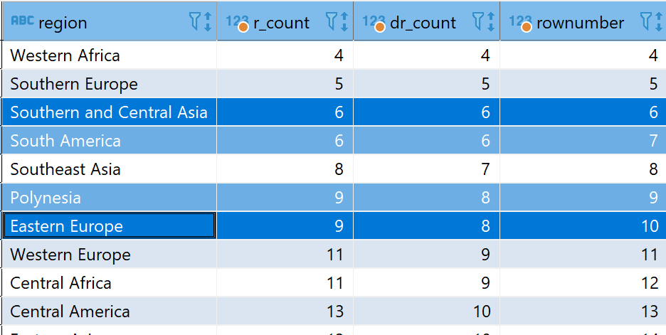
Ranking and row numbers
The query uses three functions to calculate the position of each region in the ranking by the number of countries
select
region,
rank() over(w) r_count,
dense_rank()
over(w) dr_count,
row_number()
over(w) rownumber
from country
group by region
window
w as (order by count(*) desc);

Slide 57
Ranking and row numbers
The query uses three functions to calculate the position of each region in the ranking by the number of countries
select
region,
rank() over(w) r_count,
dense_rank()
over(w) dr_count,
row_number()
over(w) rownumber
from country
group by region
window
w as (order by count(*) desc);

Slide 58
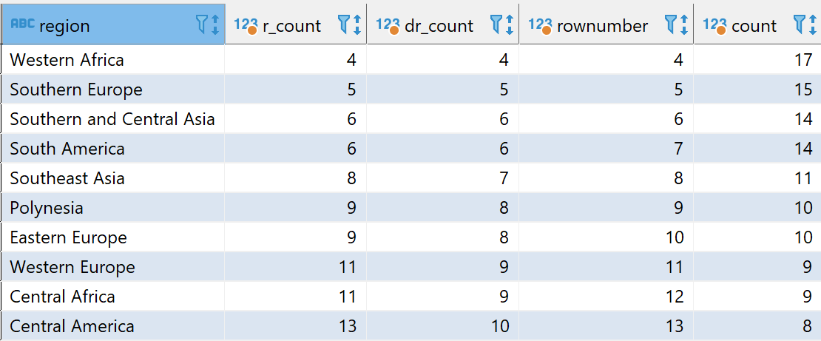
Ranking and row numbers
Duplicate values
RANK
7 was missed
DENSE_RANK
No gap between
6 and 8
ROW_NUMBER
It's just a
Row number

Slide 59
Getting the Nth value
PostgreSQL supports the NTH_VALUE window function
The function will return a single value at the desired position in the specified sort order
Let's write a query that will output the region, the number of countries, and the names of regions No1 and No3 by the number of countries

Slide 60
Getting the Nth value
Let's write a query that will output the region, the number of countries, and the names of regions No. 1 and No. 3 by the number of countries
select region,
dense_rank() over(w) dr_count,
count(*) count,
nth_value(region, 1) over(w) as region_1,
nth_value(region, 3) over(w) as region_3
FROM country
group by region
window w as (order by count(*) desc);

Slide 61
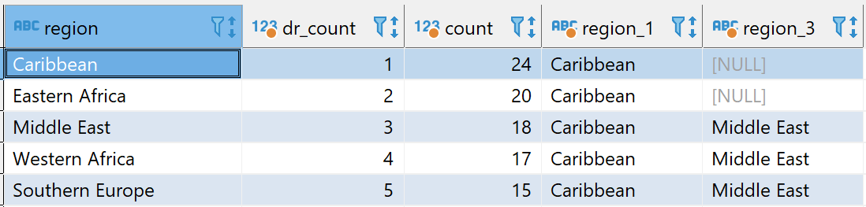
Getting the Nth value
Let's write a query that will output the region, the number of countries, and the names of regions No. 1 and No. 3 by the number of countries
Note: region_3 has no value in the first two lines

Slide 62
Getting the Nth value
Let's write a query that will output the region, the number of countries, and the names of regions No. 1 and No. 3 by the number of countries
Note: region_3 has no value in the first two lines → Need to include more lines within the window borders

Slide 63
Changing the window function frame
rows, range, groups

Slide 64
Defining window frames in a query
Window frames can be set in OVER
ROWS BETWEEN A and B
Frames are specified as relative row numbers. For example, the 5 previous entries and the current entry. The beginning and end of a group can also be specified as a boundary.
GROUPS BETWEEN A and B
Same as ROWS, but applies to groups of rows that share common field values in ORDER BY
RANGE BETWEEN A and B
Boundaries are specified as restrictions on the values of expressions in ORDER BY

Slide 65
Defining window frames in a query
N preceding
N following
Unbounded preceding
Unbounded following
Current row
N may have different meanings depending on the selected window border option – rows (ROWS), groups of rows (GROUPS) or a range of values (RANGE)
Method for determining the left and right borders

Slide 66
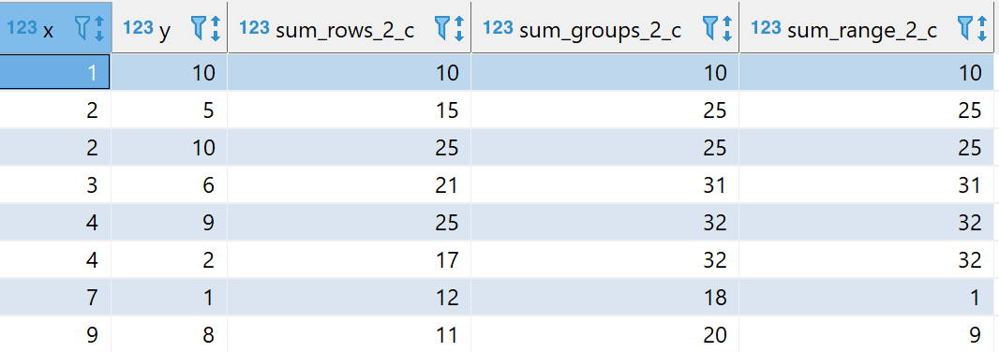
Defining window frames in a query
select
x, y,
sum(y) over(order by x rows between 2 preceding and current row) sum_rows_2_c,
sum(y) over(order by x groups between 2 preceding and current row) sum_groups_2_c,
sum(y) over(order by x range between 2 preceding and current row) sum_range_2_c

Slide 67
Defining window frames in a query
select
x, y,
sum(y) over(order by x rows between 2 preceding and current row) sum_rows_2_c,
sum(y) over(order by x groups between 2 preceding and current row) sum_groups_2_c,
sum(y) over(order by x range between 2 preceding and current row) sum_range_2_c

Slide 68
Defining window frames in a query
select
x, y,
sum(y) over(order by x rows between 2 preceding and current row) sum_rows_2_c,
sum(y) over(order by x groups between 2 preceding and current row) sum_groups_2_c,
sum(y) over(order by x range between 2 preceding and current row) sum_range_2_c
Groups (6 in this table)
31 = (2 prev.; 10) + (prev.; 5+10) + (cur.; 6)

Slide 69
Defining window frames in a query
select
x, y,
sum(y) over(order by x rows between 2 preceding and current row) sum_rows_2_c,
sum(y) over(order by x groups between 2 preceding and current row) sum_groups_2_c,
sum(y) over(order by x range between 2 preceding and current row) sum_range_2_c

Slide 70
Getting the Nth value (continued)
NTH_VALUE by default uses the current line as the right border of the window frame
Query with explicitly specified window frame:
select region,
dense_rank() over(order by count(*) desc) dr_count,
count(*) count,
nth_value(region, 1) over(order by count(*) desc rows between unbounded preceding and unbounded following) as region_1,
nth_value(region, 3) over(order by count(*) desc rows between unbounded preceding and unbounded following) as region_3
FROM country group by region

Slide 71
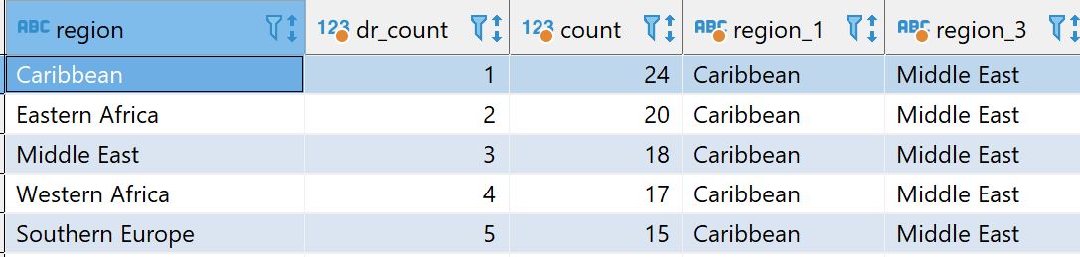
Getting the Nth value (continued)
nth_value(region, 1) over(order by count(*) desc rows between unbounded preceding and unbounded following) as region_1,
nth_value(region, 3) over(order by count(*) desc rows between unbounded preceding and unbounded following) as region_3
default
Unbounded preceding and unbounded following

Slide 72
Access previous and next lines
Lag, lead

Slide 73
Previous and next lines in a group
LAG(x, offset, default) OVER(...) – Previous value with offset
Optional parameters:
Offset – Relative position of the search string. If the string is not found, the function returns NULL or the default value.
Default – The default value replaces NULL when the function cannot find the requested data.
The default offset is 1

Slide 74
Previous and next lines in a group
Query: How has the monthly number of departures changed over time?
select
date_part('year', f.actual_departure) as yr,
date_part('mon', f.actual_departure) as mon,
count(*) as n_flights,
lag(count(*), 1, 0::bigint)
over(order by date_part('year', f.actual_departure),
date_part('mon', f.actual_departure))
as prev_n_flights,
count(*) - lag(count(*), 1, 0::bigint)
over(order by date_part('year', f.actual_departure),
date_part('mon', f.actual_departure)) as m_to_m_diff
from flights f
group by 1, 2;

Slide 75
Previous and next lines in a group
Query: How has the monthly number of departures changed over time?
select
date_part('year', f.actual_departure) as yr,
date_part('mon', f.actual_departure) as mon,
count(*) as n_flights,
lag(count(*), 1, 0::bigint)
over(order by date_part('year', f.actual_departure),
date_part('mon', f.actual_departure))
as prev_n_flights,
count(*) - lag(count(*), 1, 0)
over(order by date_part('year', f.actual_departure),
date_part('mon', f.actual_departure)) as m_to_m_diff
from flights f
group by 1, 2;
Number of flights
Sort by month
Default value
Offset = 1

Slide 76
Other built-in window functions in PostgreSQL
FIRST_VALUE
LAST_VALUE
NTILE
CUME_DIST
PERCENT_RANK

Slide 77
Thanks for attention

